Slide 1
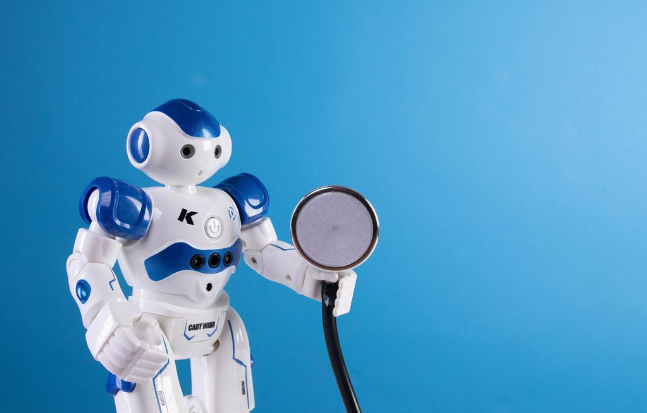
Robots in Non-Manufacturing Contexts
ME 395 Mini-Lecture
Yujui Chen,
Nigel Chew, Bryan Horn, Adam Pelberg,
Shihhsien Yang

Slide 2
Healthcare: Da Vinci Robot
A Robotic Surgical system

Slide 3
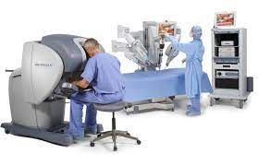
What’s the Da Vinci System?
A robotic surgical system developed by Intuitive Surgical that translates a well-trained surgeon’s hand movement into reality to operate on a patient.
3 Parts to a Da Vinci System:
Patient Cart
Surgeon Console
Vision Cart

Slide 4
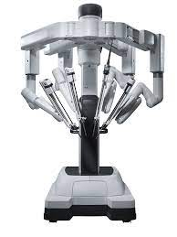
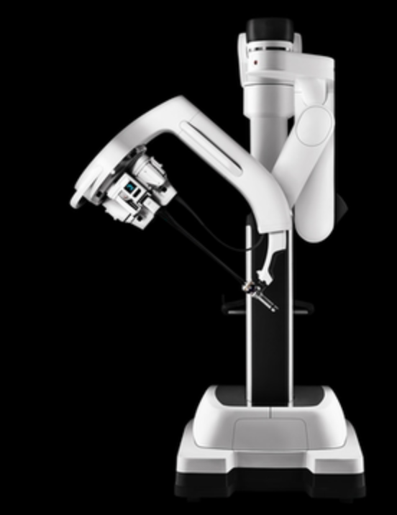
Patient Cart
Holds the instruments and sits above the patient

Slide 5
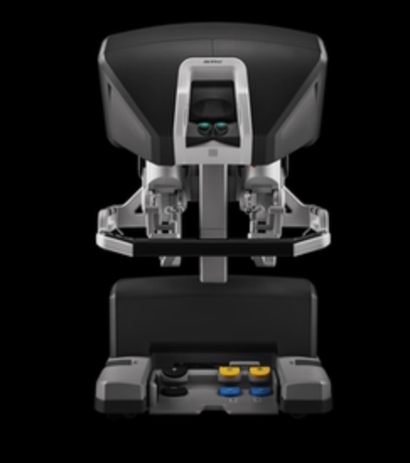
Surgeon Console
Provides 3D visual as well as instrument controlled by the surgeon

Slide 6
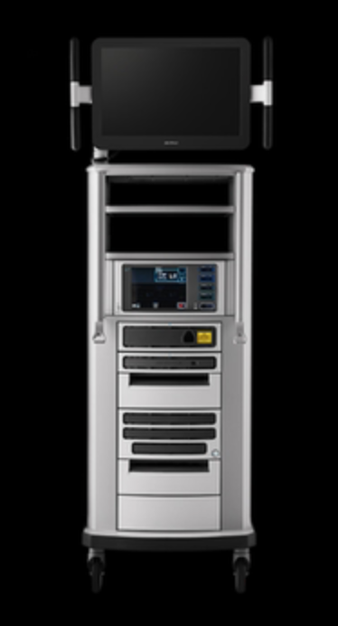
Vision Cart
Provides screen for visualization of the procedure, hub for power generation, image processing, and information systems.

Slide 7
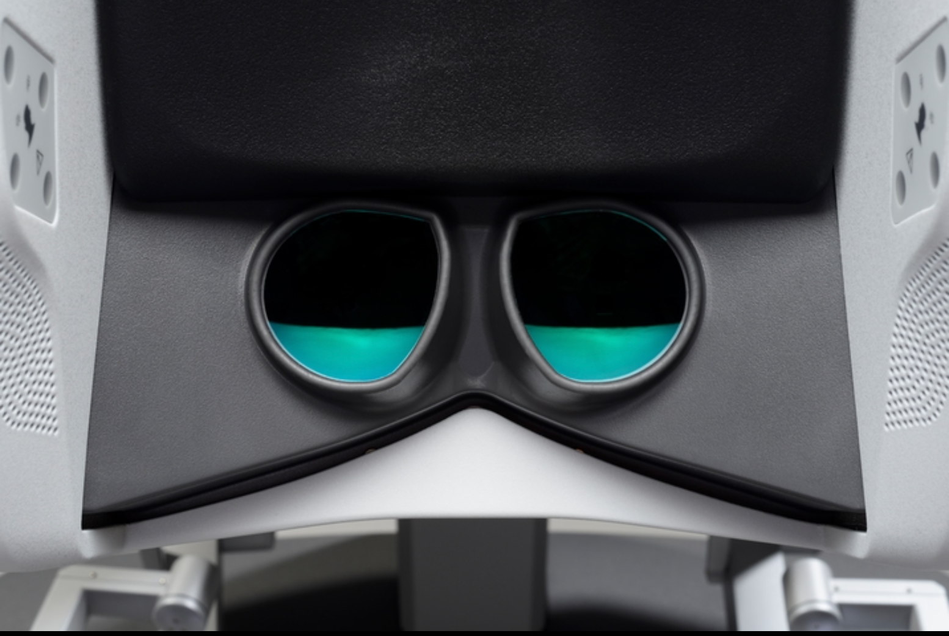
Operating From console
Adjustable:
adjusts in multiple ways to help surgeon get a good fit for the height and reach
Customizable :
All settings can be customized
Surgeon has total control of the wristed instrument on each of four arm

Slide 8
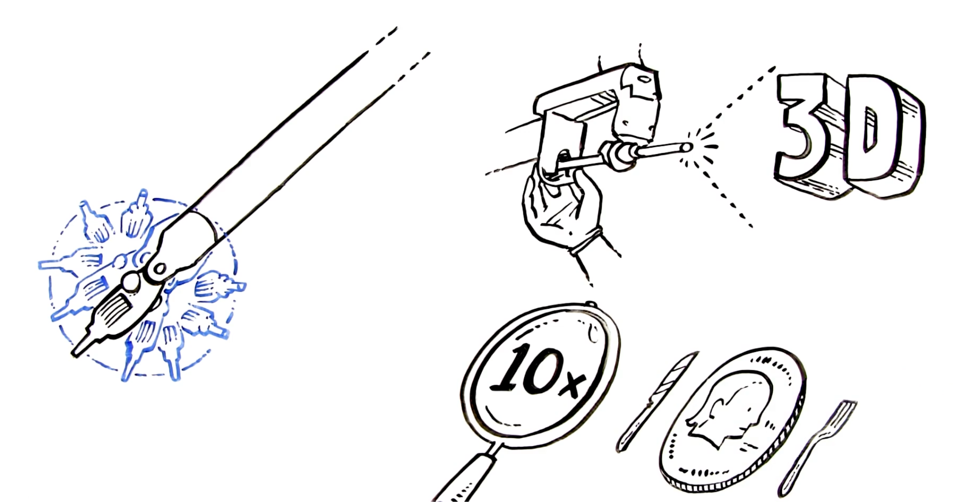
Camera
Resolution
The high-definition camera can
provides 10 times resolution images
In 3D. Giving the surgeon more clear
and accurate vision than bare eyes.

Slide 9
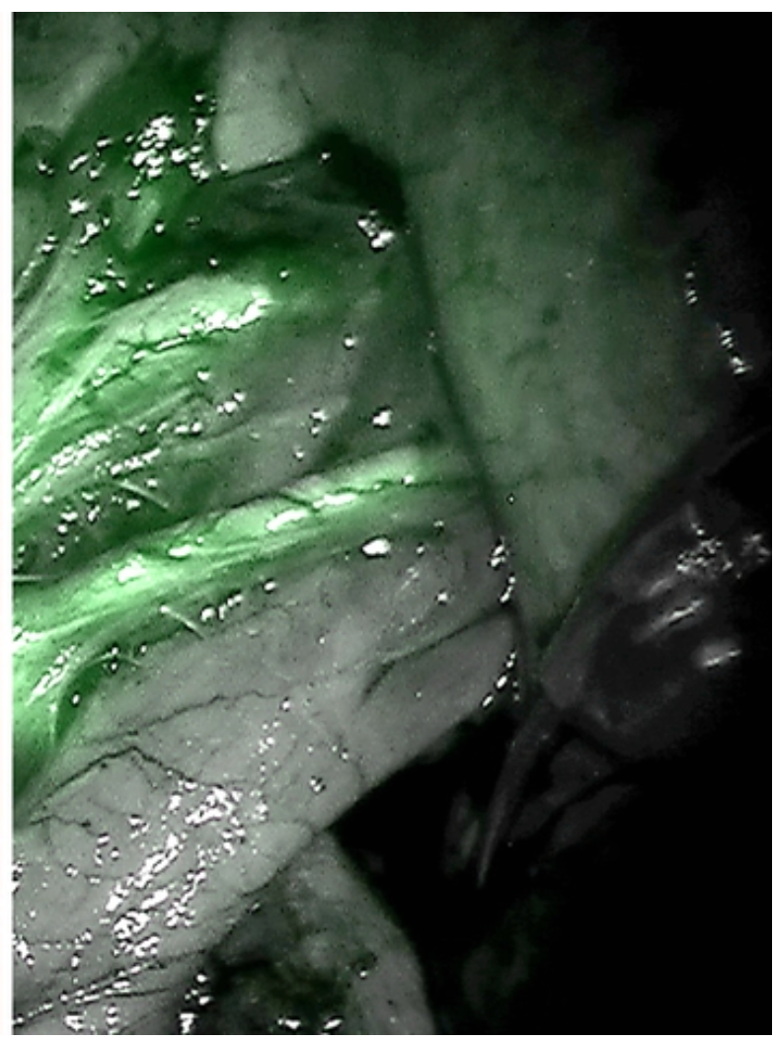
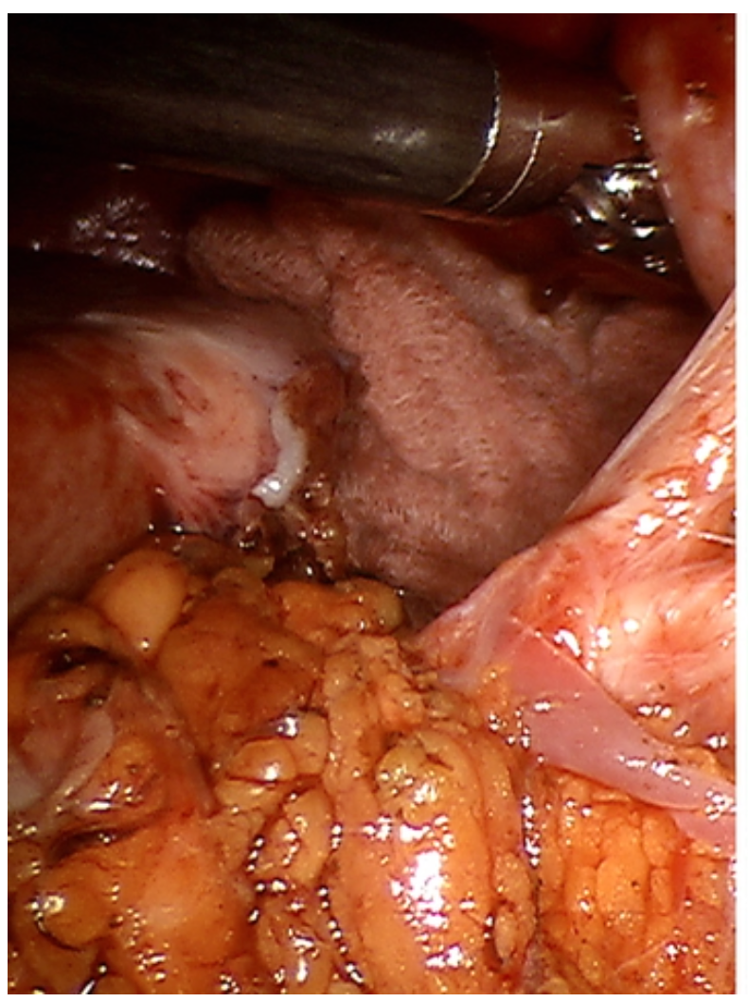
Firefly fluorescence Images
The Da Vinci camera can trigger injected dye to fluoresce, giving enhanced visuals

Slide 10
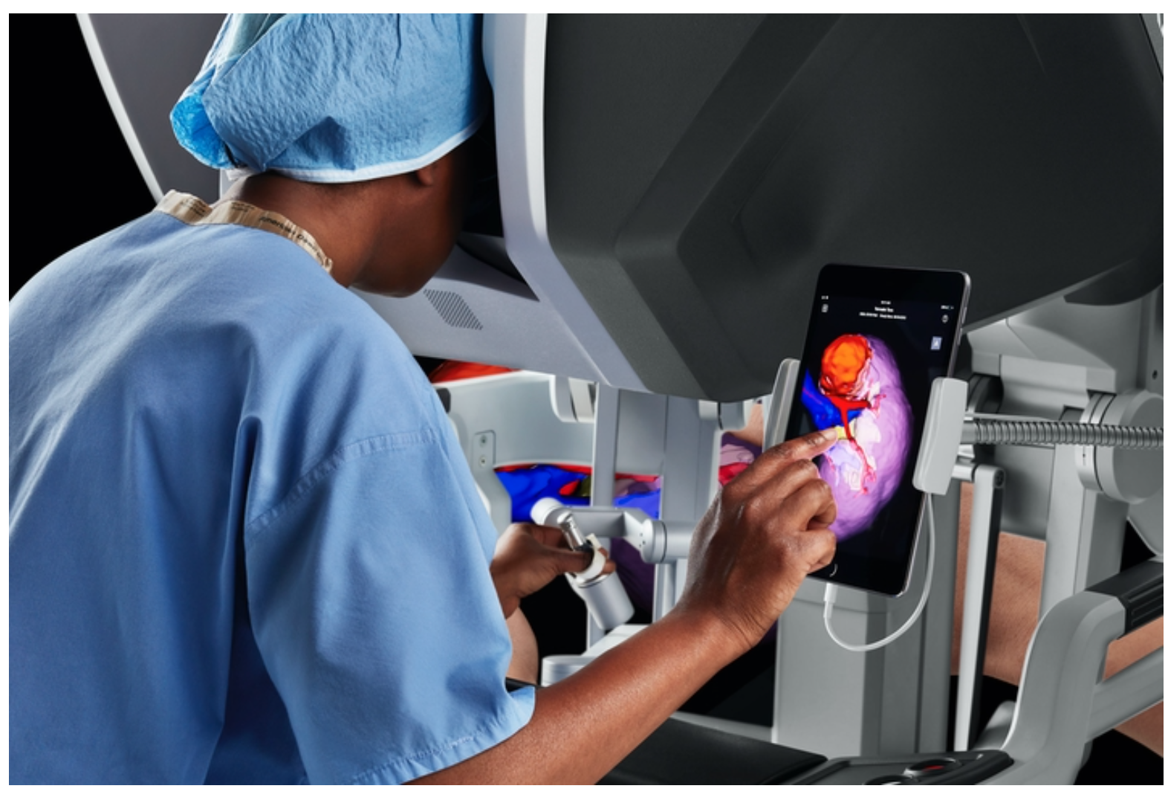
Compatible with other visual system
Using CT scans, a segmented 3D model of anatomy can be created to help prepare for surgery.
During the procedure, the surgeon can view the model at the Da Vinci Surgeon Console and manipulate it on any mobile device.

Slide 11
What happens during robotic surgery
01
Placing ports (thin tubes)
03
Operation
02
04
Visualization
Changing instrument
The surgeon makes one or more small incisions (only finger tip size), and places the ports
Surgical instruments are placed through the other ports that allows the surgeon to do the operation through robot arm at a console.
A long thin camera is placed through one of the ports, which provides high-definition images in 3D to console.
For different surgeries, there are specific steps in order, which need various instruments. So, an assistant should change the instruments if needed

Slide 12
Pros & Cons
Pros
Cons
1. Minimally invasive
2. Less pain/scarring
3. Lower risk of complications
4. Shorter hospital stays
5. More dexterity for surgeon
6. Lower fatigue for surgeon
1. No standard tactile feedback for Surgeon (yet)
2. Higher costs
3. Risk of malfunctioning
4. Massive learning curve on the equipment
Lower risk/
higher operability
Applicability

Slide 13
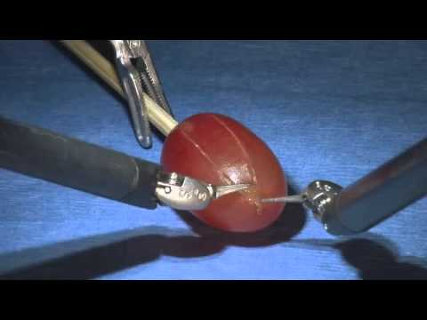
It does a pretty grape job…

Slide 14
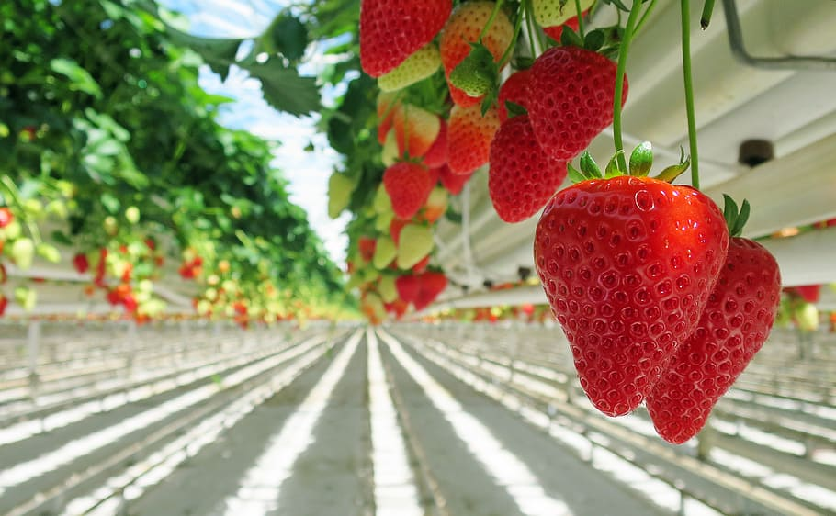
Agriculture: Agrobot
Robotic high-tech farming equipment

Slide 15
Table of contents
Agrobot
Fruit Identification
01
Introduction of Agrobot
04
Computer Vision methods
Navigation
Deep Learning
02
Navigation methods
05
Deep Learning Methods
Gripper
Robotic Arm
03
Gripper designs with applying motion method
06
Applying different DOF

Slide 16
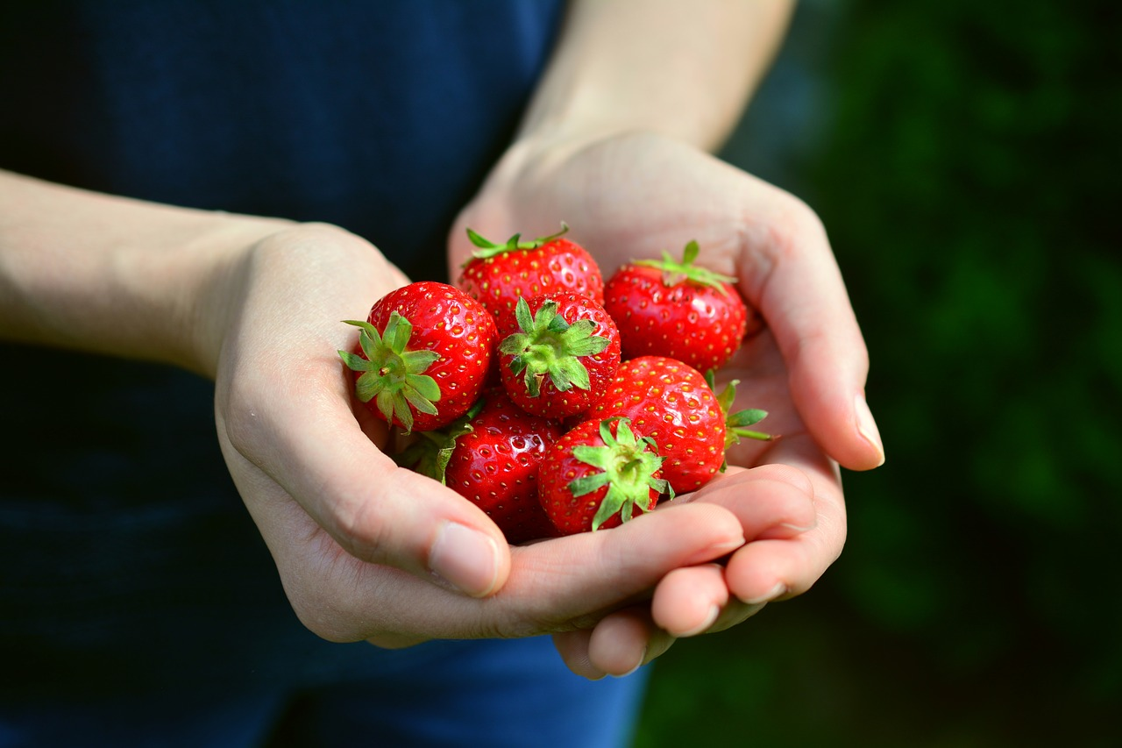
Agrobot

Slide 17
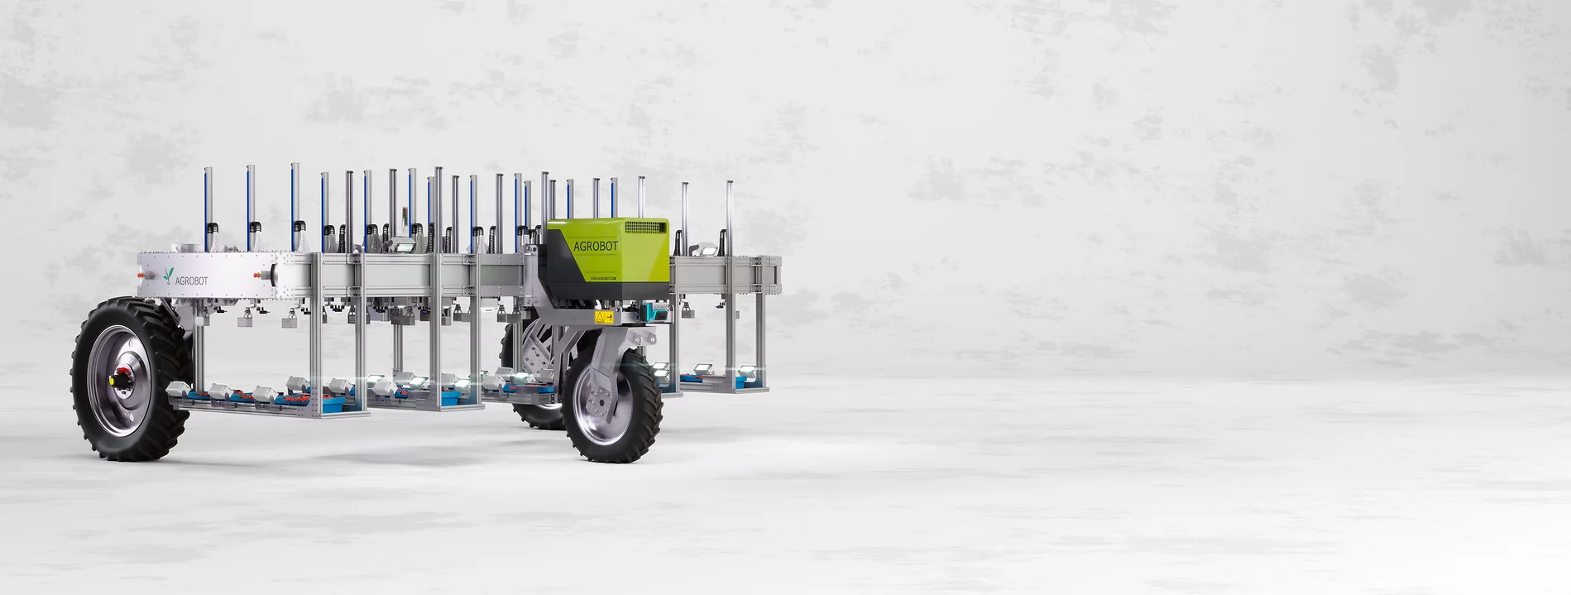
What is the Agrobot?
The first pre-commercial robotic harvester for gently harvesting strawberries.

Slide 18
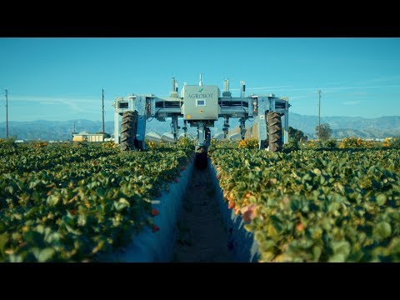
Characteristics
Adaptable Configuration
Up to 24 independent robotic arms
Flexible platform
High Reliability
Robustly operates with a high degree of precision
Self-reliant decentralized arms

Slide 19
Characteristics [cont.]
Real Time AI
Short-range integrated color and infrared depth sensors
Cutting-edge graphic processing
Gentle Harvest
Does not contact the fruit
Active Safety
LiDAR sensors ensure workers stay safe

Slide 20
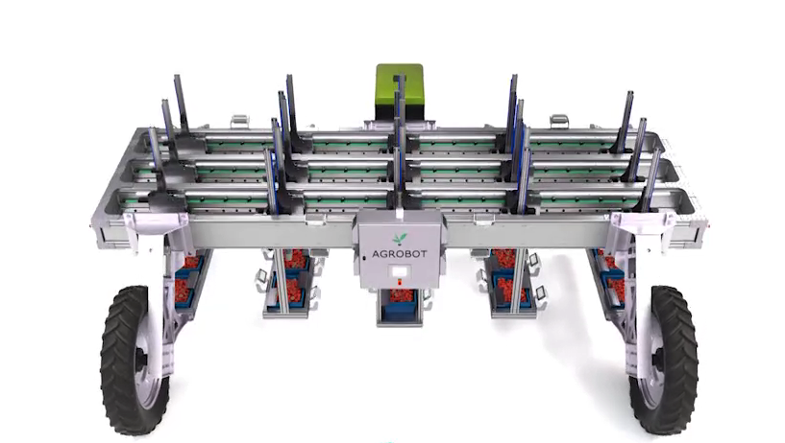
Technic in Agrobot

Slide 21
Navigation
LiDAR | Targets an object with a laser Measures the time for the reflected light to return This determines the object’s distance | How it’s used: Makes sure to keep surrounding field workers safe Uses LiDAR sensors to identify workers Has a virtual perimeter which stops the harvester when crossed
GPS | A satellite-based radionavigation system

Slide 22
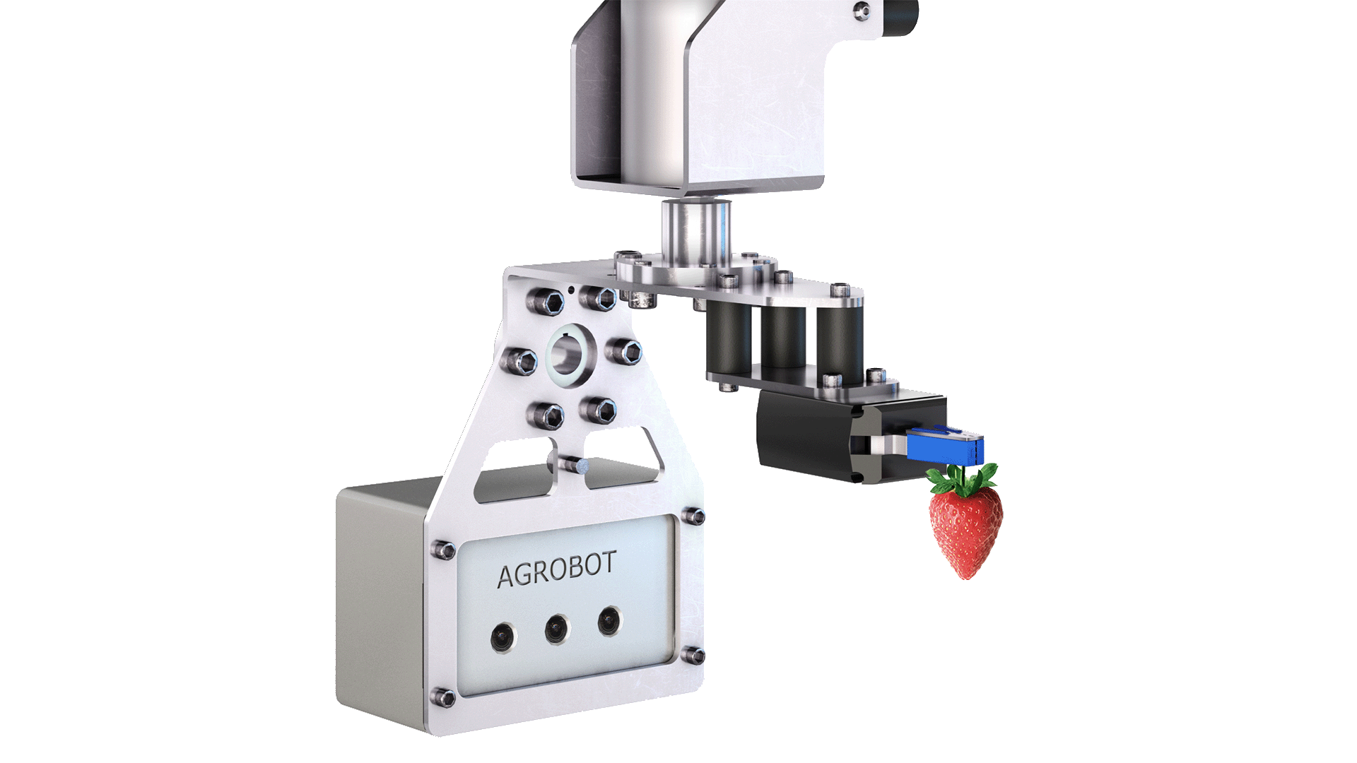
Gripper
Mimics a scissor
Grips at the stem and cuts below it
Drops strawberries into field container

Slide 23
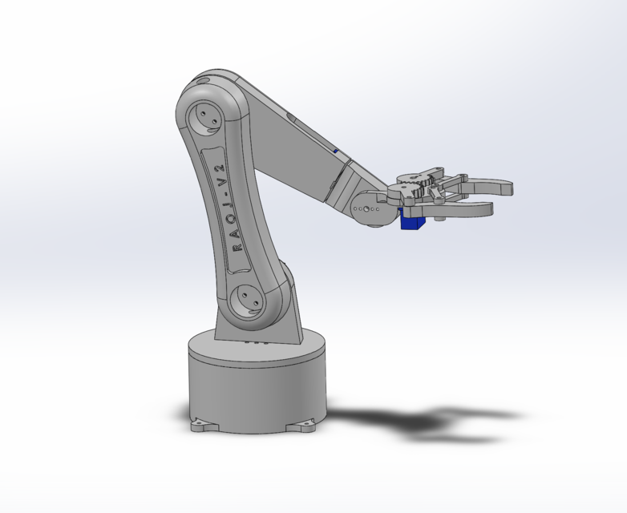
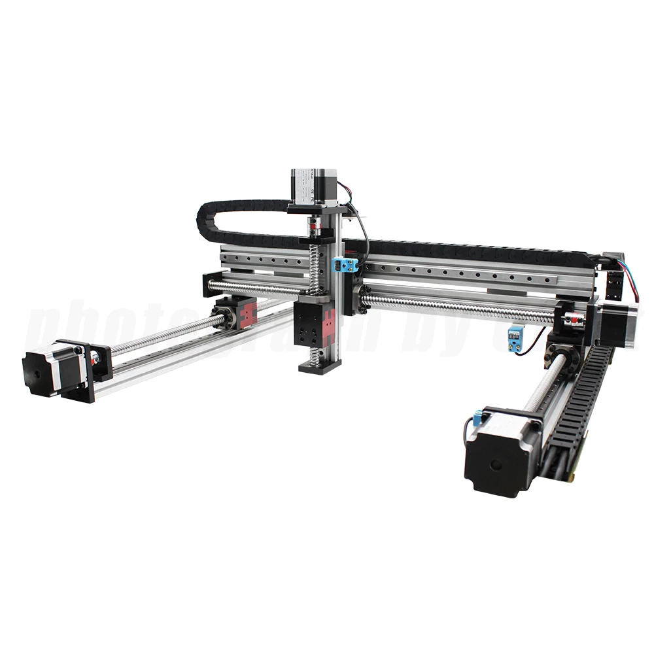
Robot Arm
5 DOF
3 DOF
The 3-DOF Cartesian arm is widely used due to its simplicity and low cost. Moreover, unlike the serial arm, it has no singularity problem and it has a wider working area if no rotations are required.
The 5‐DOF arm is high cost and its orientation will lock, keeping the gripper horizontal. This also made its working space small

Slide 24
Fruit Identification
Image Processing
Deep Learning
Short-range integrated color and infrared depth sensors are used to capture all details
Cutting-edge graphic processing units help to assess fruit ripeness.
Convolutional autoencoder and backpropagation neural network is used

Slide 25
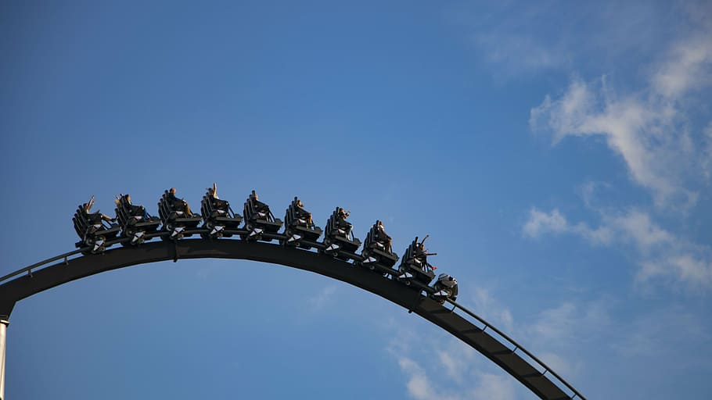
Amusement: Robocoaster
A new generation of thrill ride

Slide 26
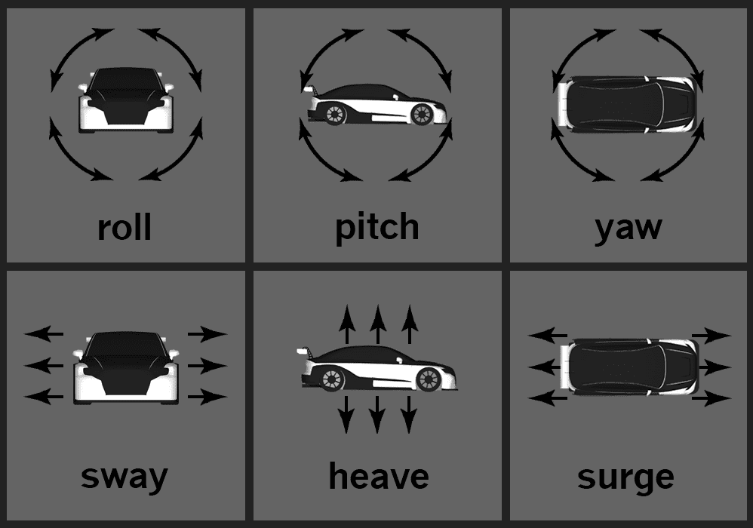
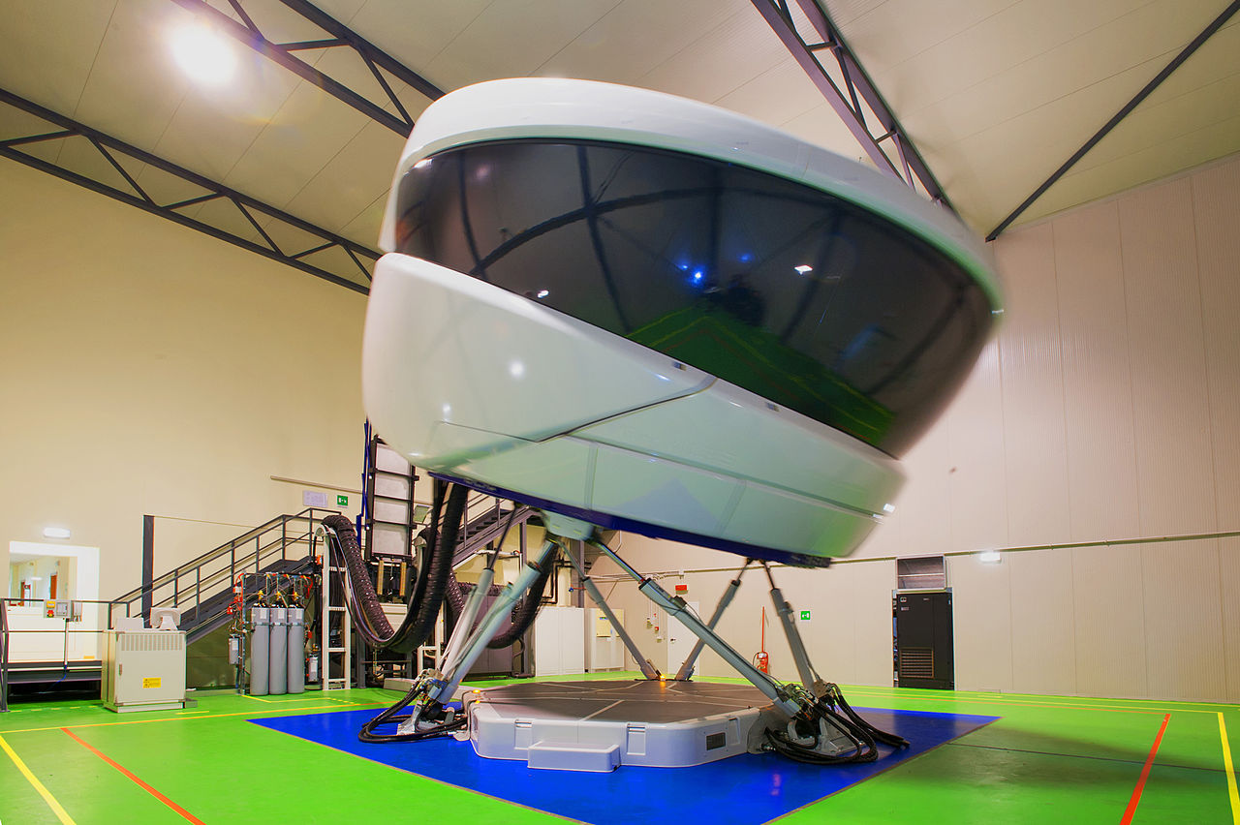
Conventional Motion Simulator Rides
Conventional motion simulation ride vehicles achieve 6 degrees of freedom

Slide 27
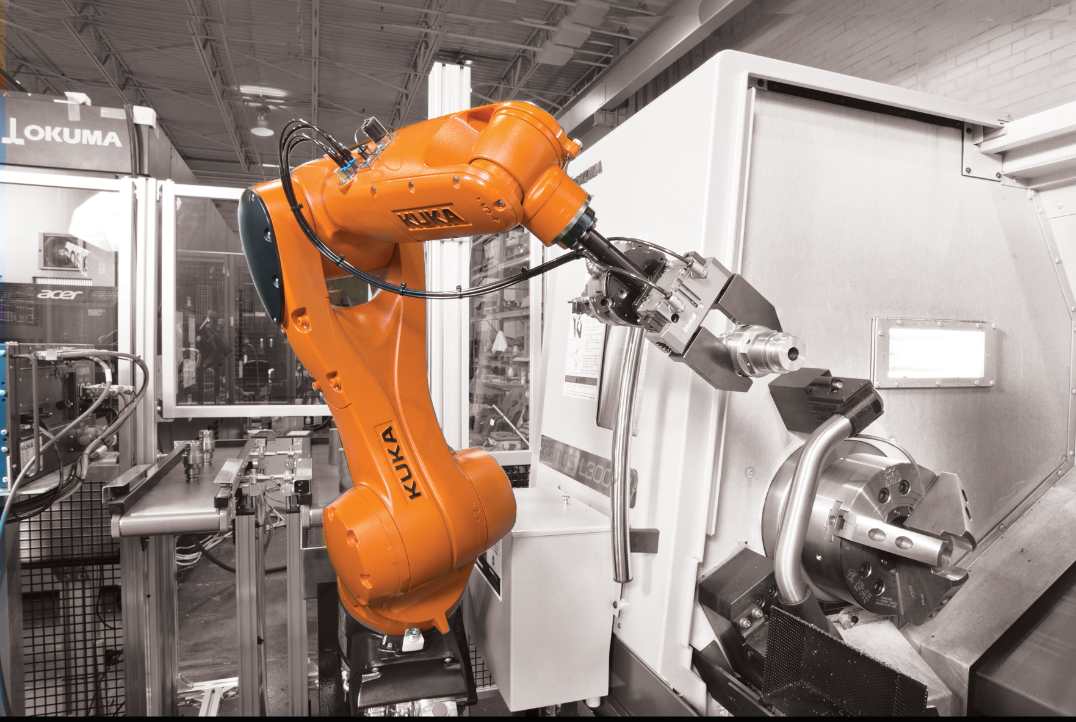
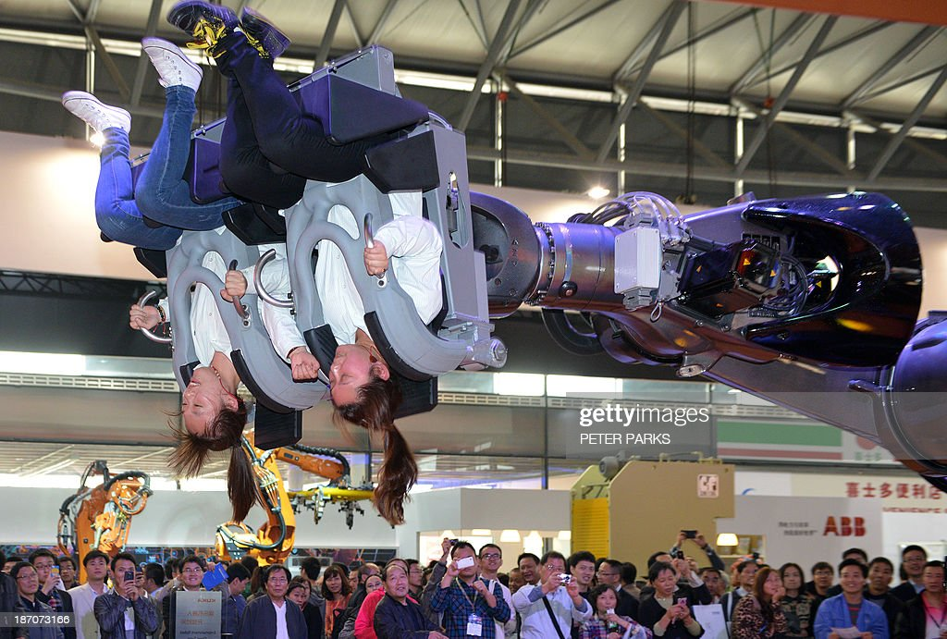
Kuka Arm Robocoaster
First developed in 2000 by Gino De-Gol when the idea was hatched to mount a chair to the end of an industrial robotic arm

Slide 28
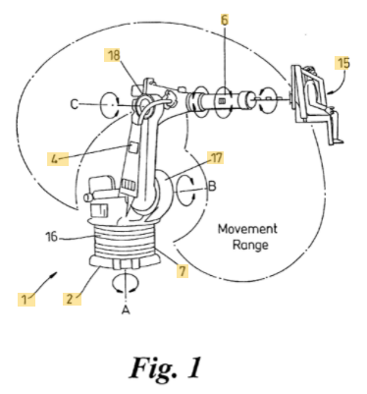
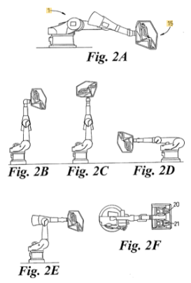
Six-axis Kuka arm robots allow for a much larger range of motion, performing larger swoops (vs traditional motion base ride)
Swoops can let riders experience nearly 2Gs

Slide 29
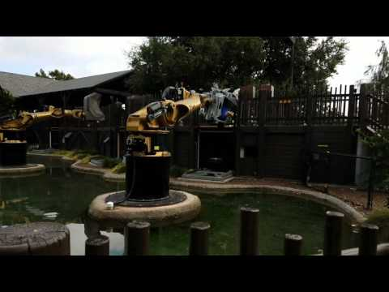
1st Gen Robocoaster
Base fixed in place
Ex: Knights’ Tournament, Legoland
Can allow guests to choose intensity level, or even ‘design’ ride motion

Slide 30
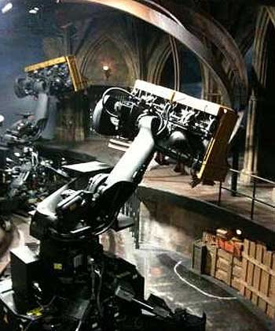
2nd Gen Robocoaster
Base of arm attached to a bus bar track system that allowed it to move through different show scenes.
Ex: Harry Potter & the Forbidden Journey, Universal’s Islands of Adventure

Slide 31
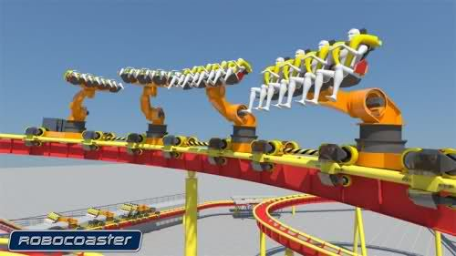
3rd Gen Robocoaster
Arm mounted to a roller-coaster track!
Not yet built! Still in conceptual phase

Slide 32

A slide to end things off
Interactive element

Slide 33
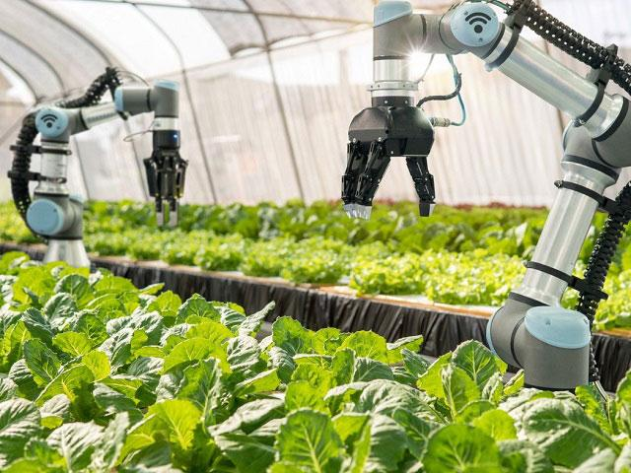
Q&A

